Slide 1

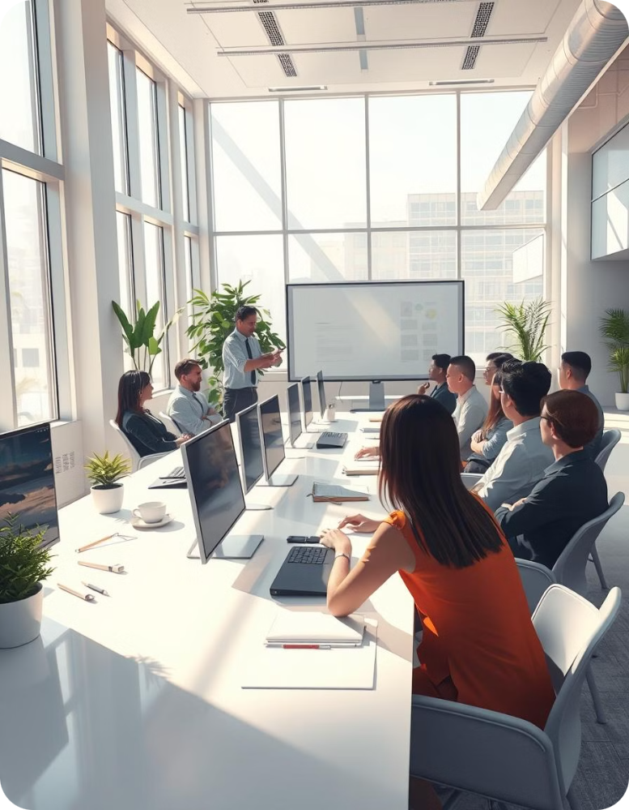



Website Presentation
Welcome to our website presentation.
Our Team
Sheetal Bajaj
Shaurya Shekhar
Nemat Hussain

Slide 2

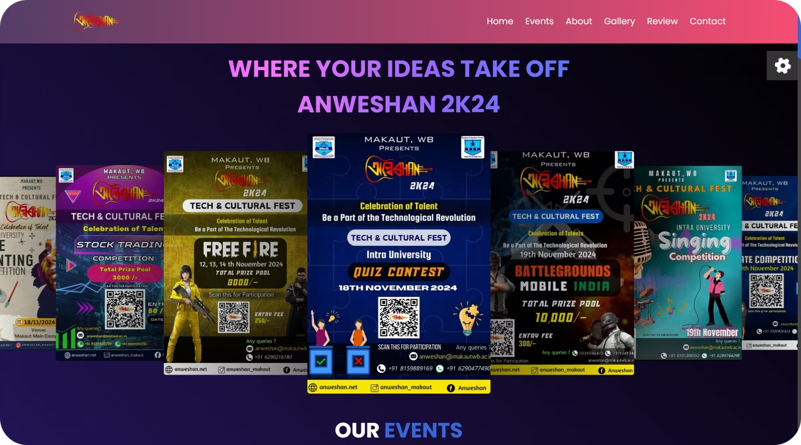
Project Overview
A centralized platform providing detailed information and registration forms for all college events, ensuring seamless event management and participation.

Slide 3
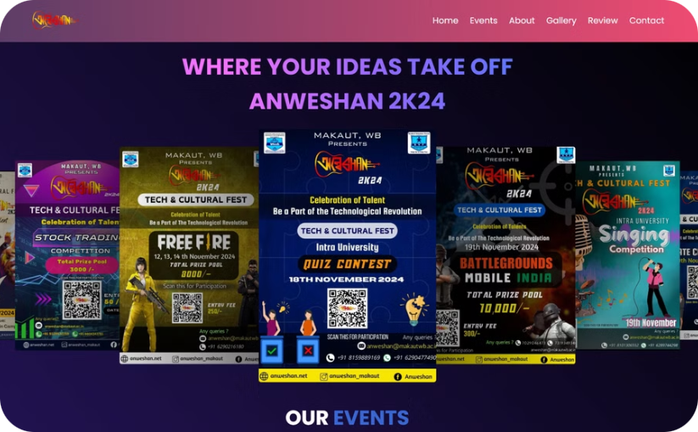
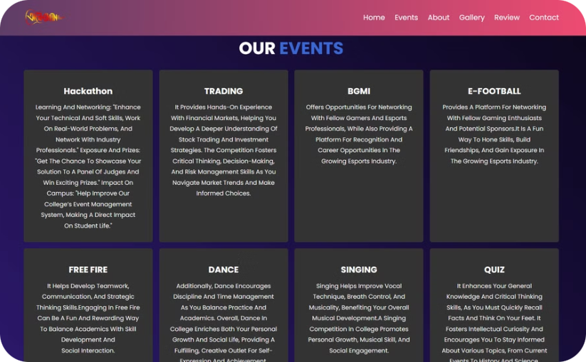
Features & Functionality
Our website offers several features.
Interactive Elements
Informative Content
Engaging elements for user interaction.
Provides valuable information.

Slide 4
Technical Foundation
Crafted using the latest web development tools for optimal performance and interactivity.
Front-End
HTML, CSS, and JavaScript.

Slide 5

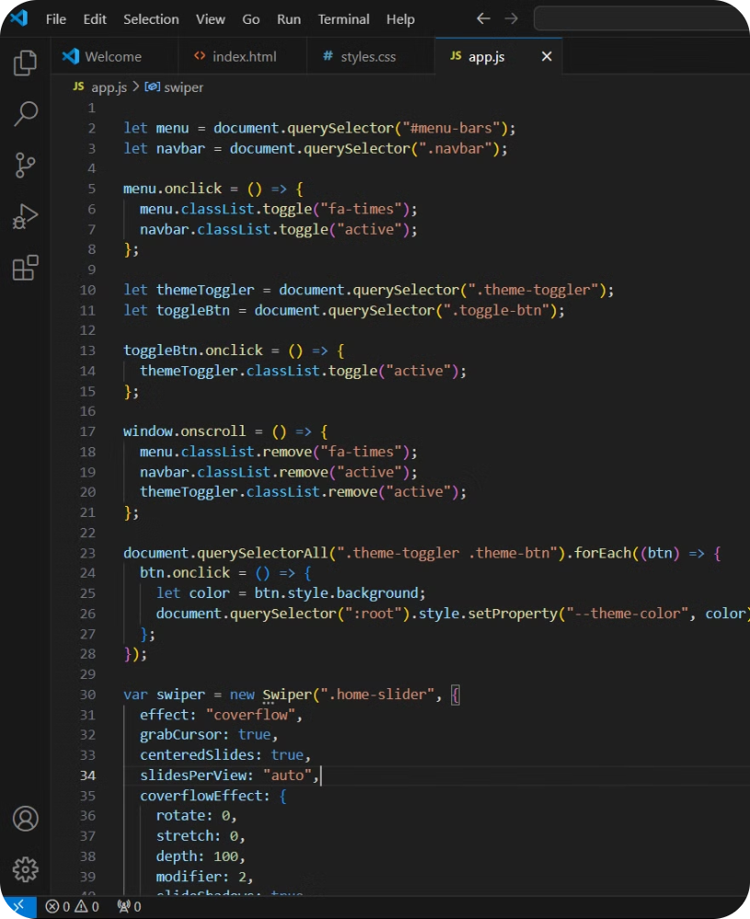



Development Proces
Planning & Design
Our planning and design focused on a clear layout for event details, easy access to registration forms, and a responsive, mobile-friendly experience.
Code Development
Our code development focused on building efficient, clean, and responsive functionality, ensuring smooth interactions and seamless event registrations.
Publishing
Our publishing process involved deploying the website on a reliable platform, ensuring fast load times and seamless accessibility across all devices

Slide 6
Website Demonstration
Let's see how it works.
HOME PAGE
ABOUT US
REVIEW
Our homepage features a slideshow showcasing all college events, allowing users to directly access the registration form by clicking on a specific event slide.
Our ABOUT US section offers insights into our mission, vision, and the purpose behind organizing these events.
Our REVIEW section highlights user testimonials, showcasing positive feedback and experiences from students and event organizers.
1
2
3
4
5
6
OUR EVENTS
OUR GALLERY
CONTACT US
OUR EVENTS section provides detailed information and highlights the significance of each event.
Our GALLERY section showcases a vibrant collection of moments captured from various college events.
Our CONTACT US section provides an easy way for users to reach out for inquiries or support, with a simple contact form and direct communication options.

Slide 7




Achievements & Learning
Valuable lessons learned.
Project Completion
New Skills Acquired
Teamwork & Communication
Delivering a functional website.
Mastering new programming techniques.
Effective collaboration with others.

Slide 8


Explore the final product at https://euphonious-chimera-c38cff.netlify.app/ and discover a world of exciting college events!
Thank you!

